Slide 1
ASEAN IPA Siem Reap 2025
Session 2: E-Commerce and IP Enforcement Strategies
Dan dougherty, david haskel, eddie wu, Tomoya Kurokawa (panelists)
Soh Kar Liang (facilitator)

Slide 2
SMALL vOLUMES

Slide 3
IPR Border Enforcement of Taiwan Customs

Slide 4
Average Articles/Values Per Case
Average articles per case
Average values per case (*k USD)

Slide 5
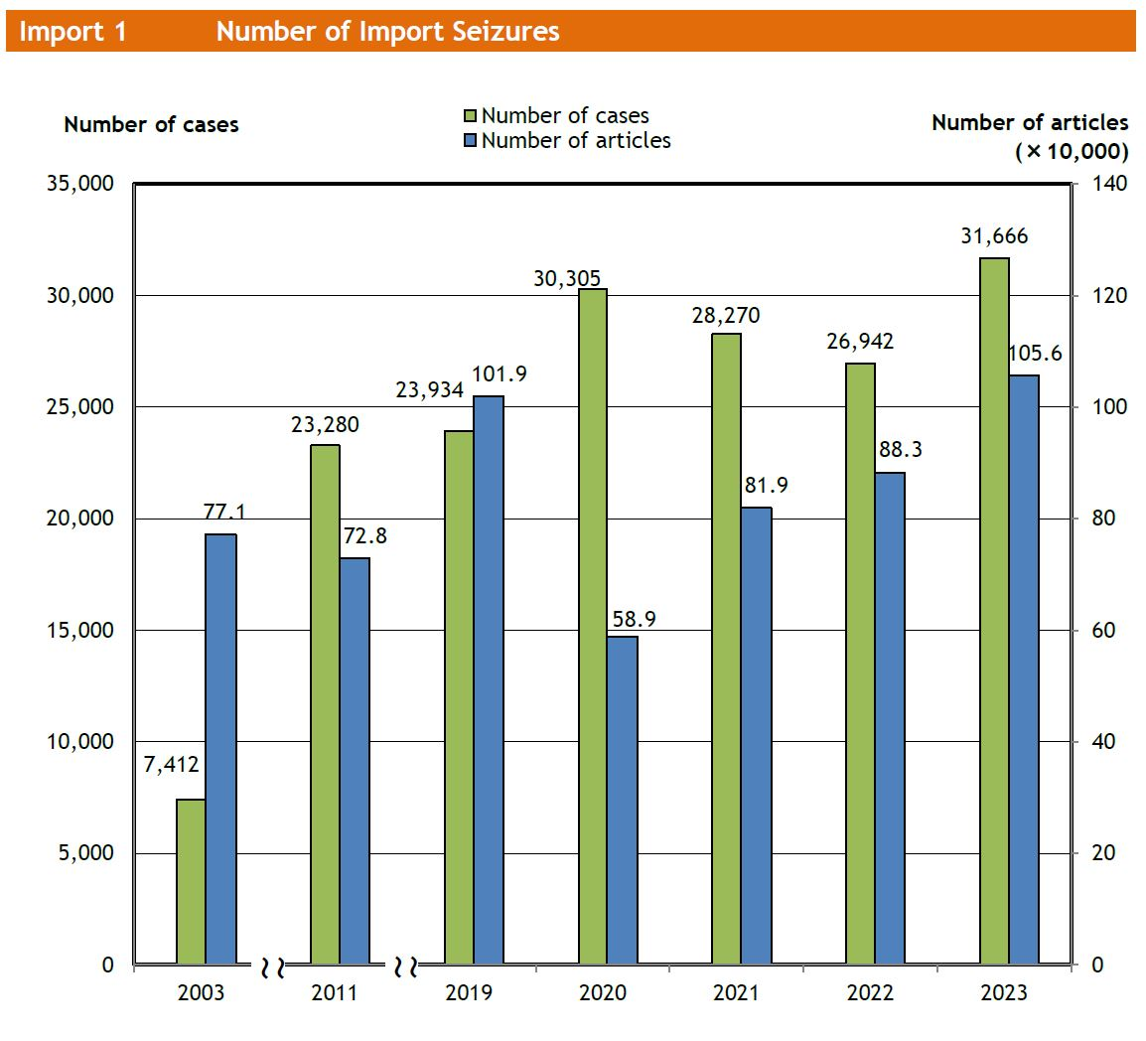
IPR Border Enforcement of Japan Customs ~Statistics on 2023~
*The above is taken from the Japan Customs website.

Slide 6
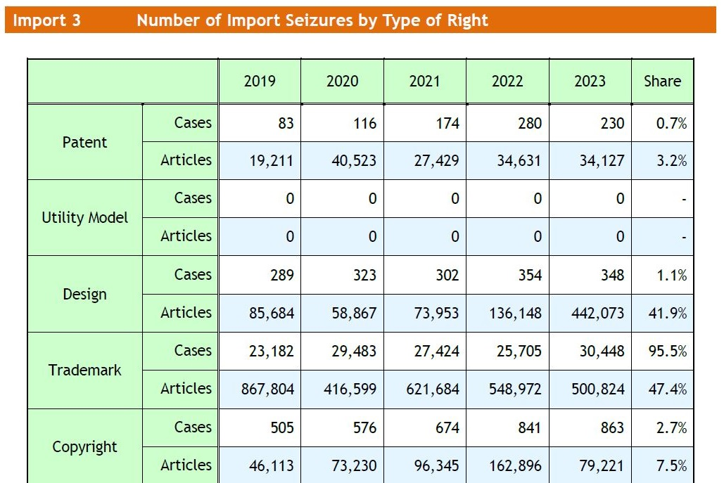
IPR Border Enforcement of Japan Customs ~Statistics on 2023~
*The above is taken from the Japan Customs website.

Slide 7
IPR Border Enforcement of Japan Customs ~Statistics on 2023~
*The above is taken from the Japan Customs website.

Slide 8
IPR Border Enforcement of Japan Customs ~Law amendments on 2022~
Before September 30, 2022
There had been a sharp increase in cases where overseas vendors sell and send small amounts of counterfeit goods directly to individuals in Japan via postal mail, etc.
In such cases, if the importer claims during customs procedures that the goods are for “private use,” it had been difficult to confiscate them.
On or after October 1, 2022
The bringing of counterfeit goods by overseas vendors into Japan commercially via postal mail, etc. is specified as an infringement of trademark rights.
It prevents the inflow of counterfeit goods, including for private use, into Japan during the customs procedure.

Slide 9
IPR Border Enforcement of Japan Customs ~Law amendments on 2022~
*The diagram above is taken from the JPO website.

Slide 10
Platform RESPONSIBILITY

Slide 11
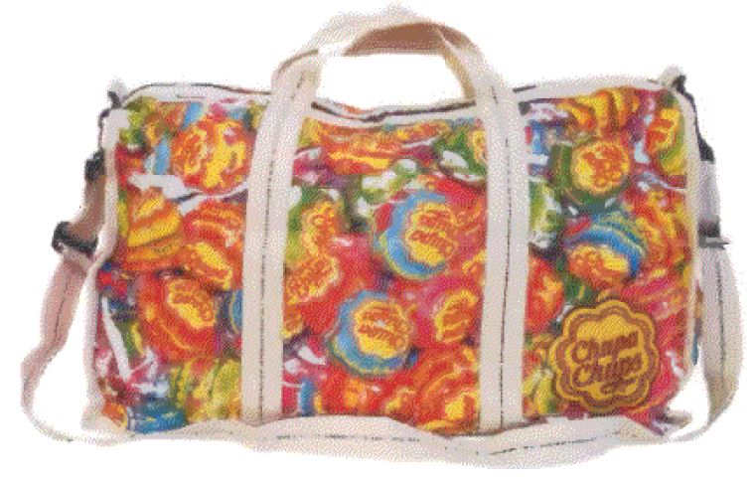
Responsibility of Internet Shopping Mall Operator ~Japanese IP High Court decision on February 14, 2012~
Overview of the Case
Plaintiff
Perfetti Van Melle
Defendant
Rakuten
Trademark Infringement
Registered mark:
Internet shopping mall
Shop A
Shop B
…
Goods:
Headwear, bags, etc.

Slide 12
Responsibility of Internet Shopping Mall Operator ~Japanese IP High Court decision on February 14, 2012~
Court Decision
The Internet shopping mall operator is deemed to infringe a trademark right if the Internet shopping mall operator:
(1) provides the operating system, approves or rejects applications from store owners, and manages and controls the suspension of services to store owners,
(2) receives benefits from store owners, such as basic store opening fees and system usage fees,
(3) becomes aware of or has reasonable grounds to believe that a store owner has infringed a trademark right, and
(4) fails to remove the infringing content from the web page within a reasonable period of time.

Slide 13
Responsibility of Internet Shopping Mall Operator ~Japanese IP High Court decision on February 14, 2012~
Court Decision -cont’d-
The defendant, Rakuten, removed the infringing content from the web page within a reasonable period of 8 days after it became aware of it.
Therefore, it cannot be said that the defendant’s operation of the Internet shopping mall infringed the plaintiff’s trademark right.

Slide 14
others

Slide 15
Unfair Competition Law Updates in Japan Virtual Imitation Infringement
On or after April 1, 2024
Imitation of a configuration of another person’s goods is considered as unfair competition even in the digital space, and injunctive relief and claims for damages can be exercised.
Genuine
goods
Counterfeit
goods
Digital space
Real space
Unfair competition
Genuine
goods
Counterfeit
goods

